Slide 1
Single Piston Brake Caliper SolidWorks design
By Andrew Morhan

Slide 2
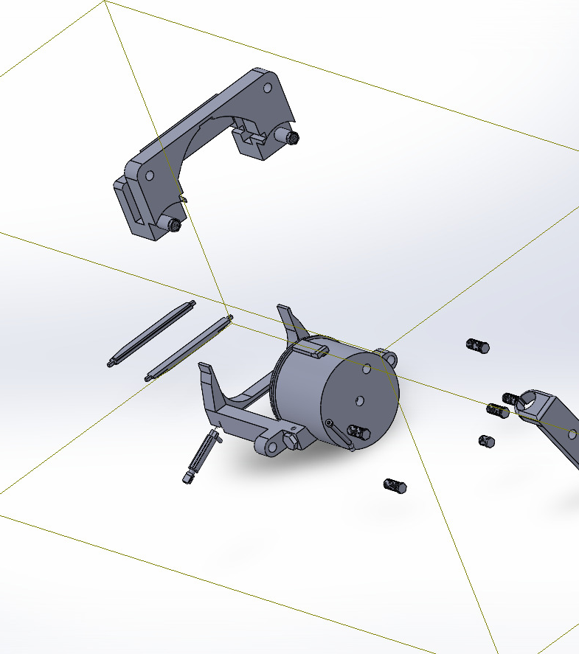
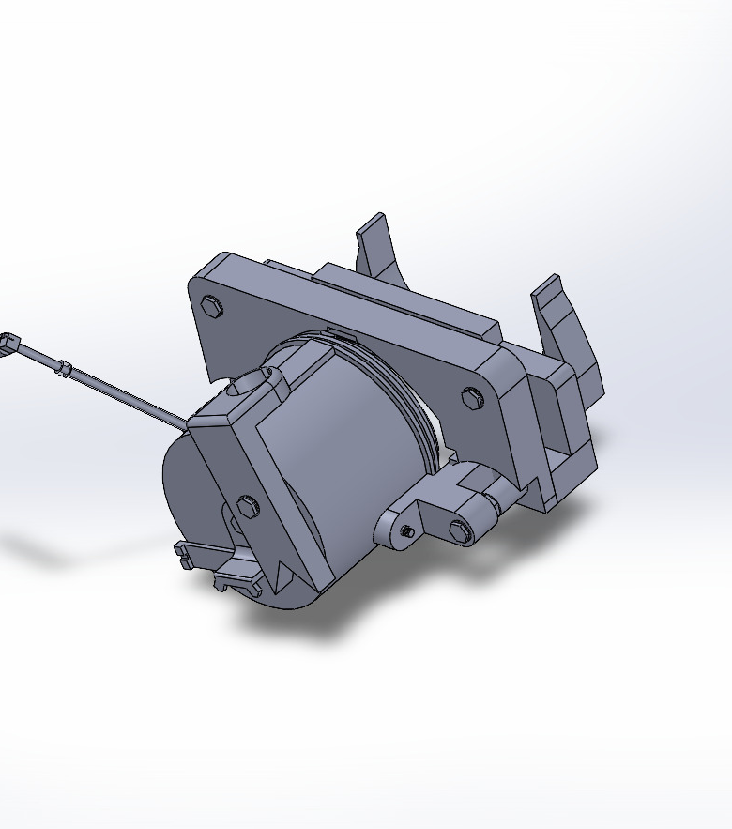
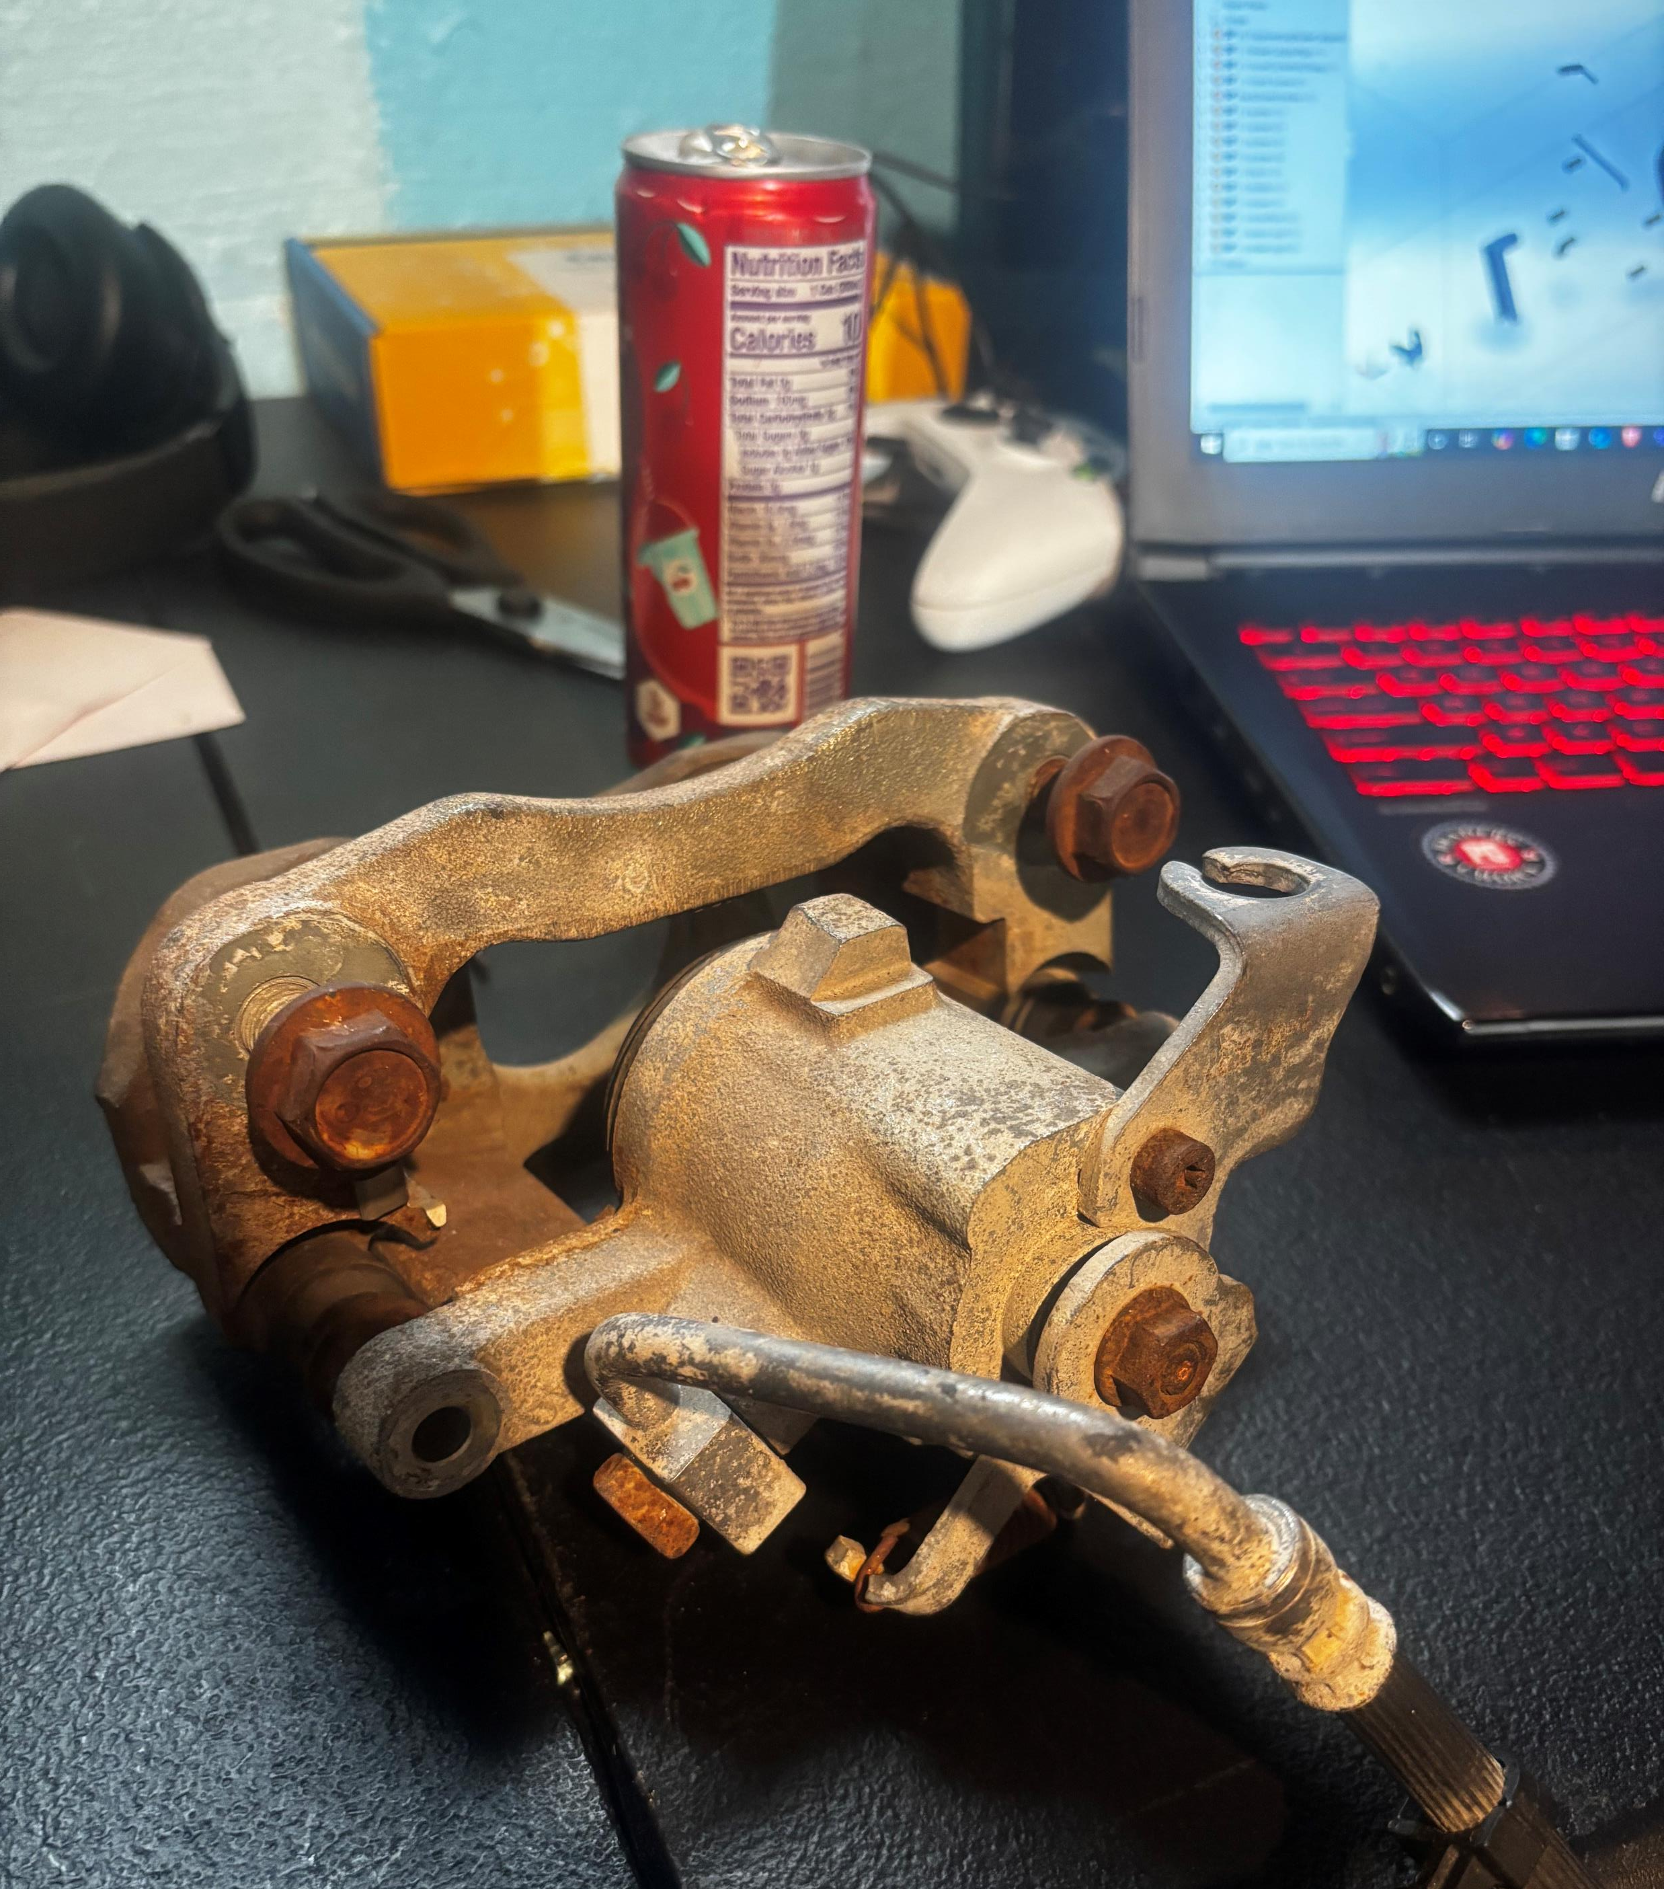
Reference SolidWorks Product

Slide 3
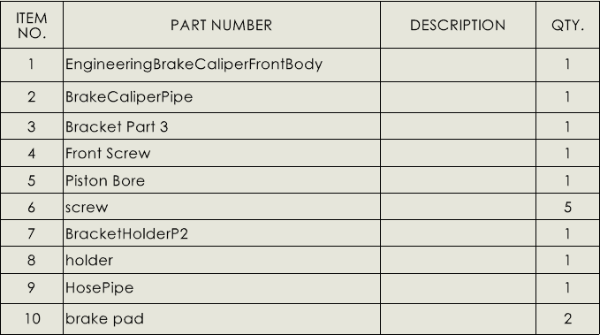
Bill of Materials

Slide 4
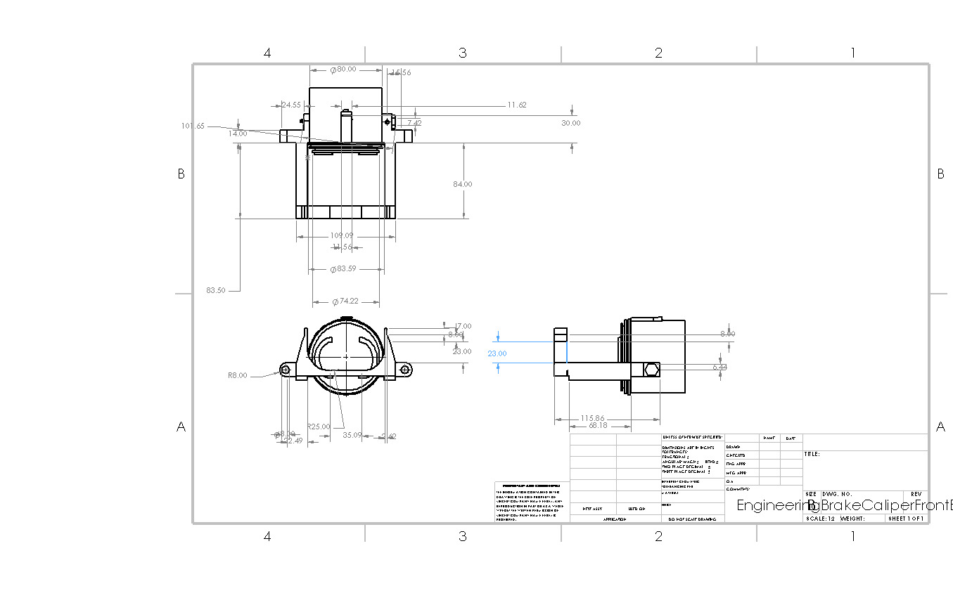
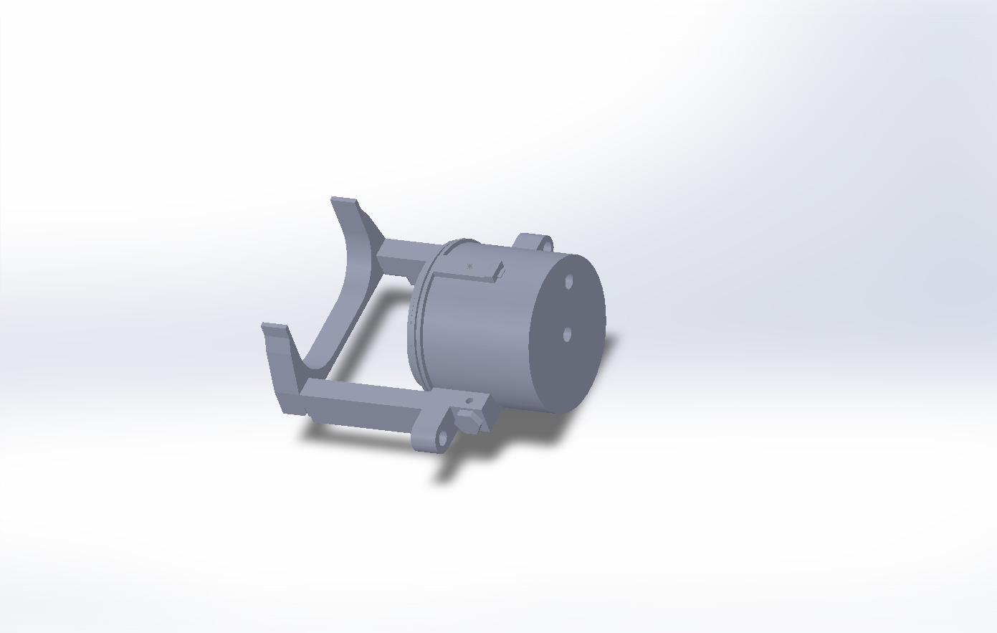
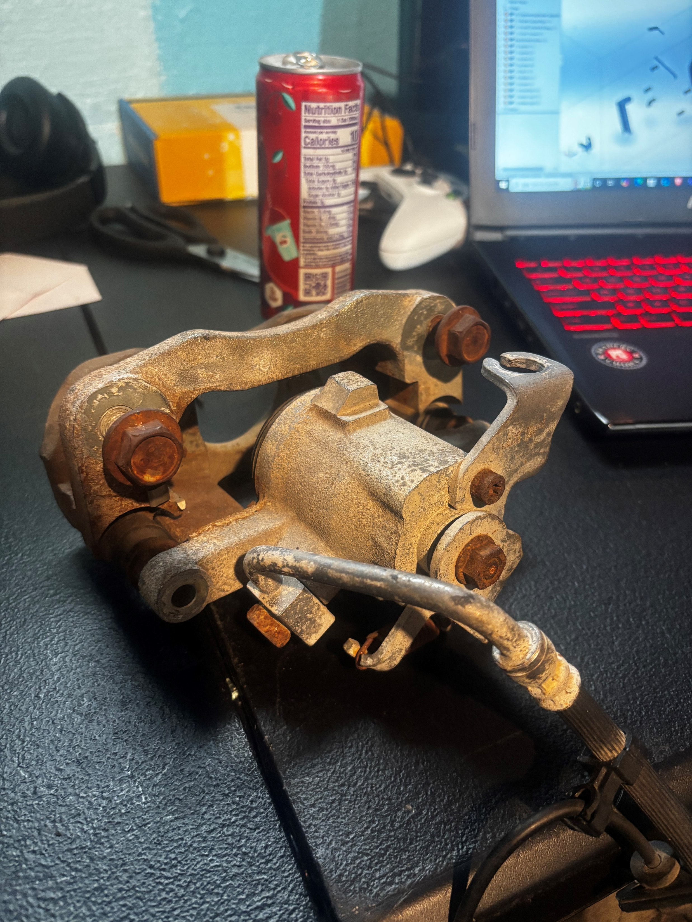
Caliper Body
Used to hold the Bracket holders
Used to insert the brake rotor
The Caliper Body is the main, rigid structure that integrates all the hydraulic and mechanical parts required to convert fluid pressure into friction.

Slide 5
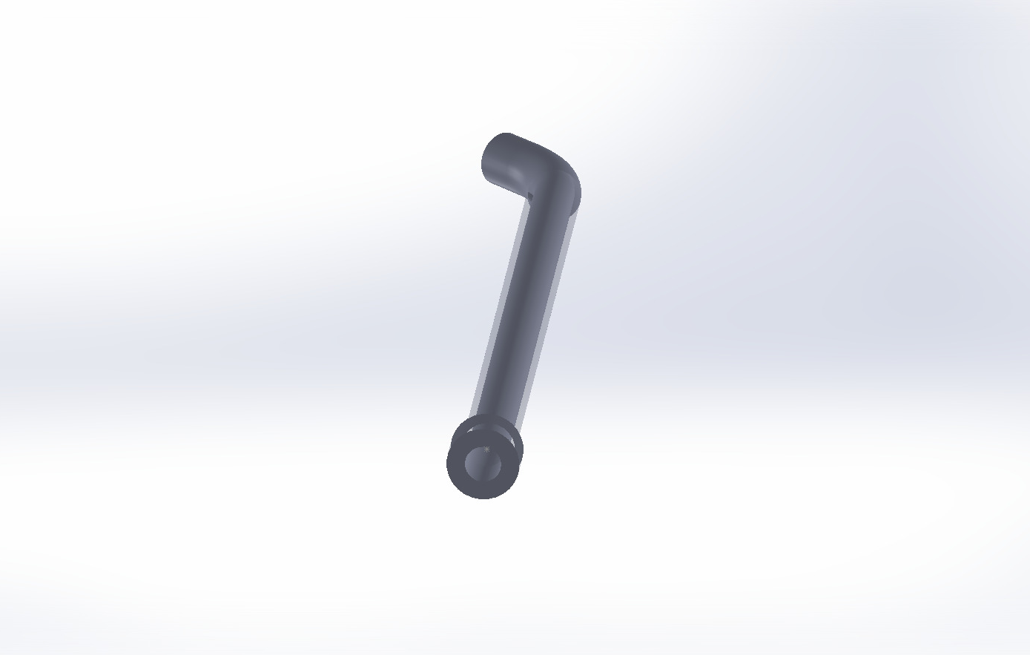
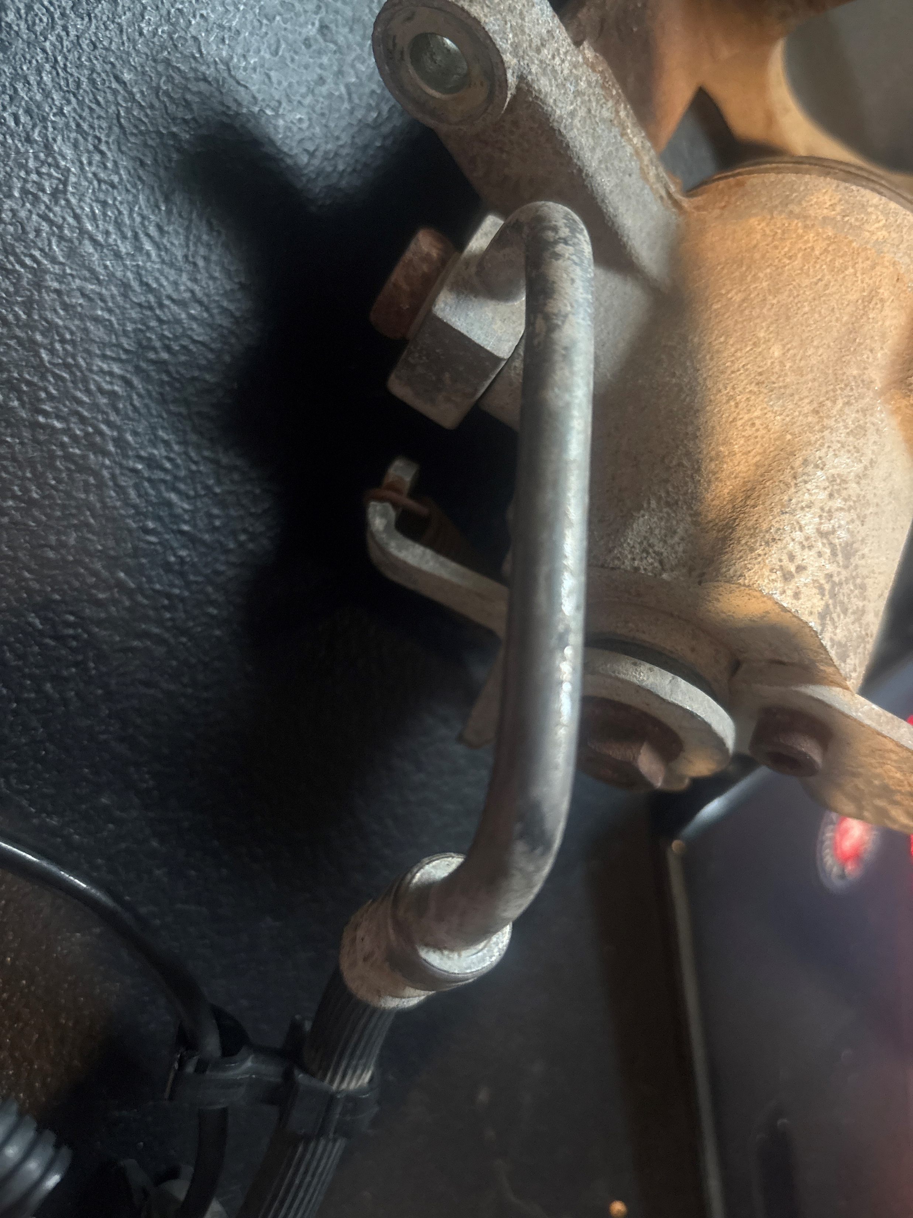
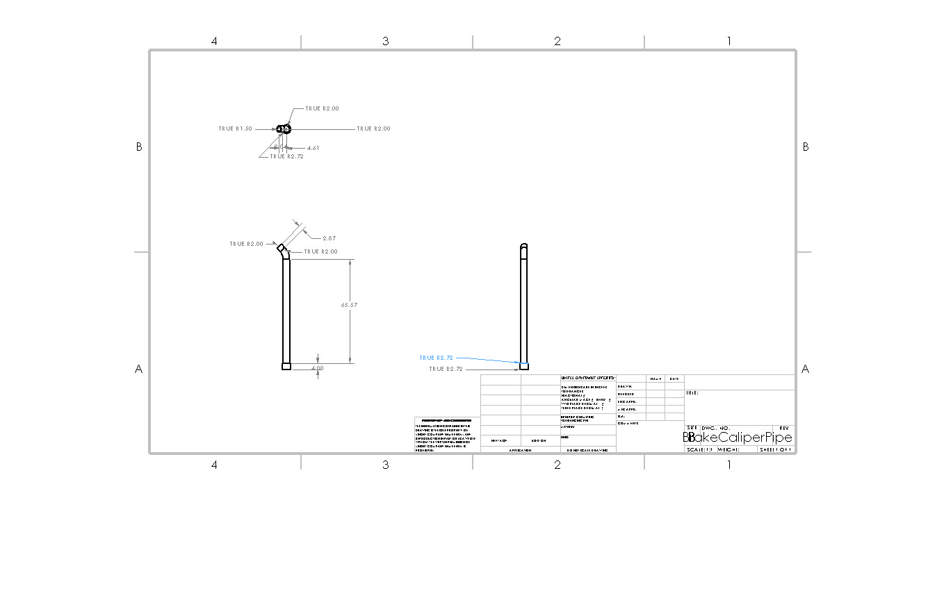
Brake Line
-run along the car's frame/undercarriage from the master cylinder to the wheel area.

Slide 6
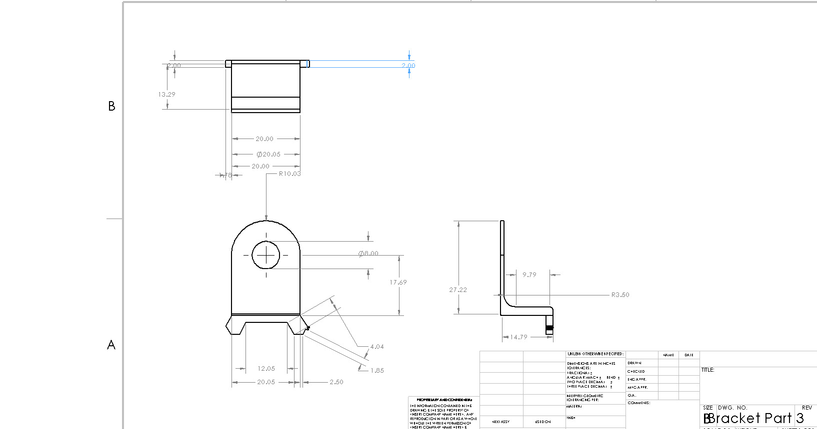
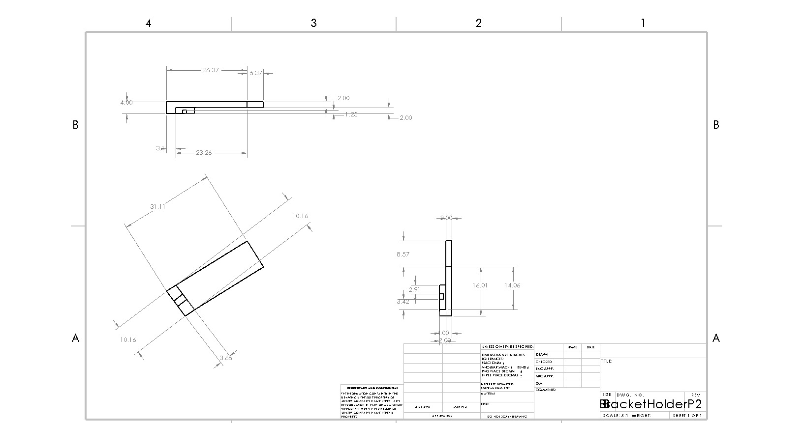
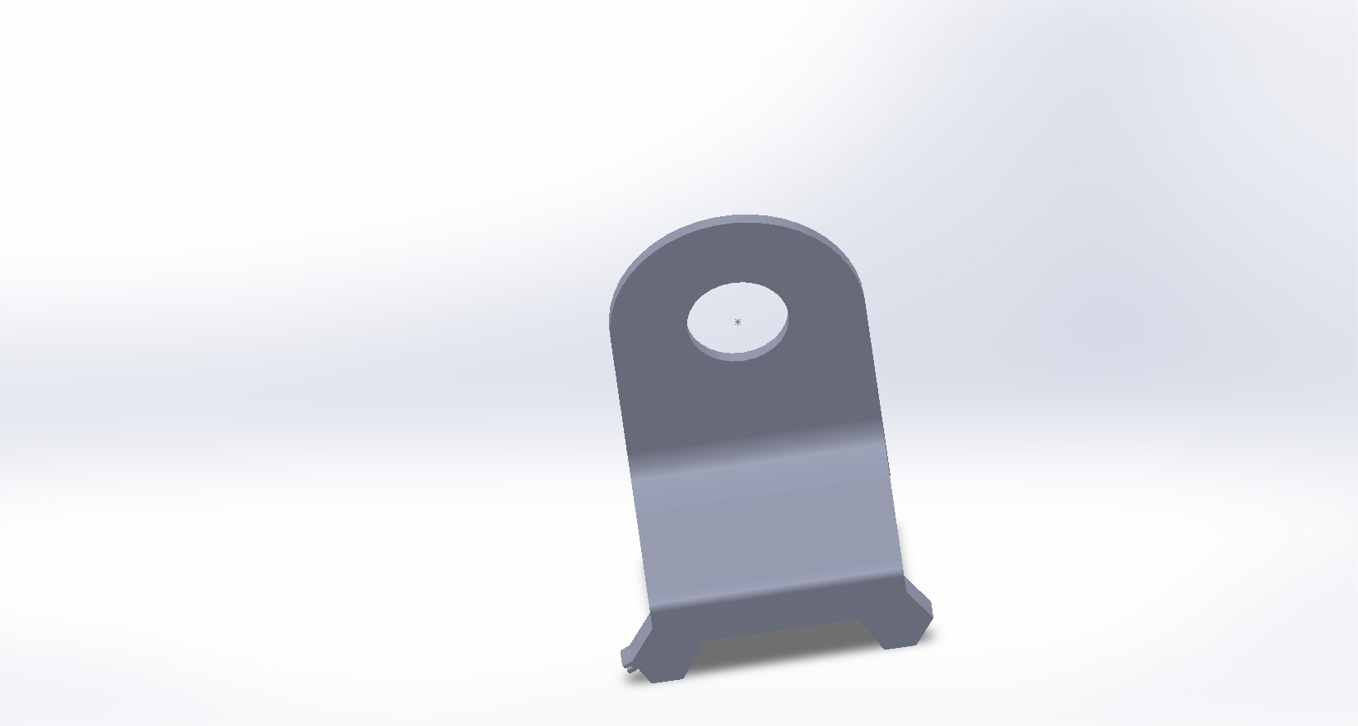
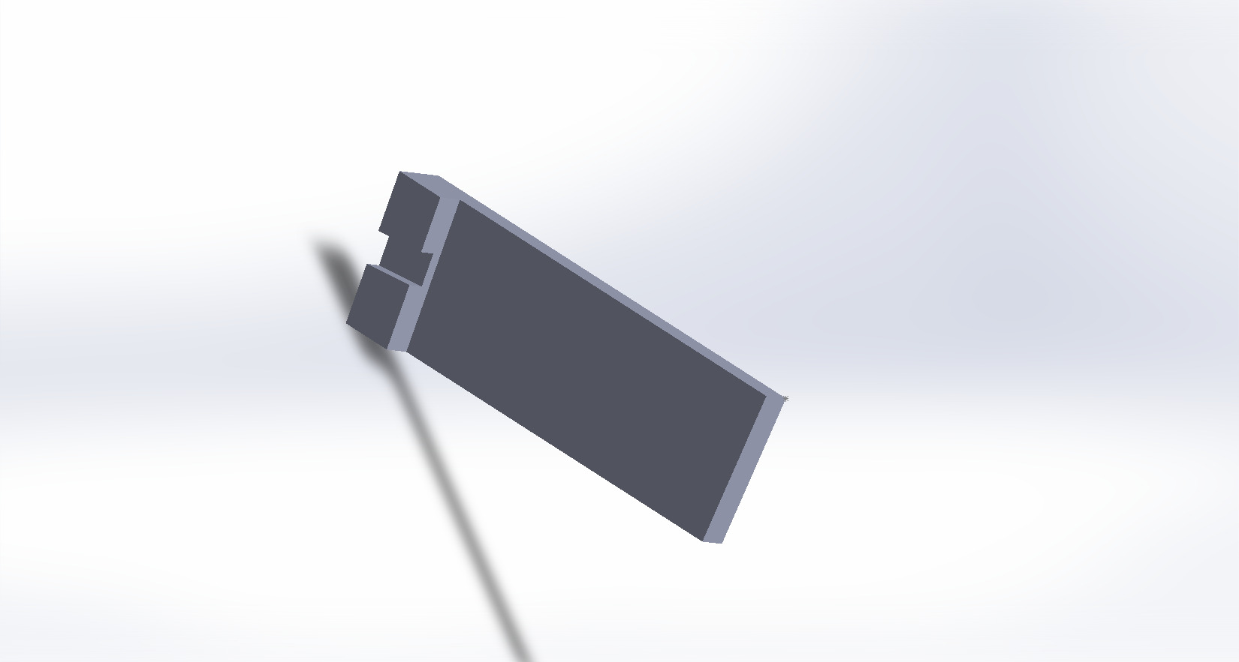
Brackets part 1 and 2

Slide 7
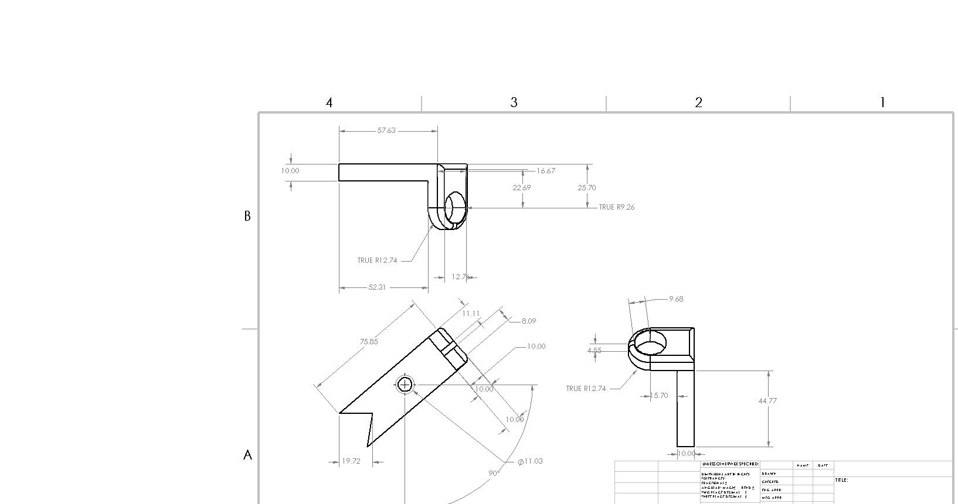
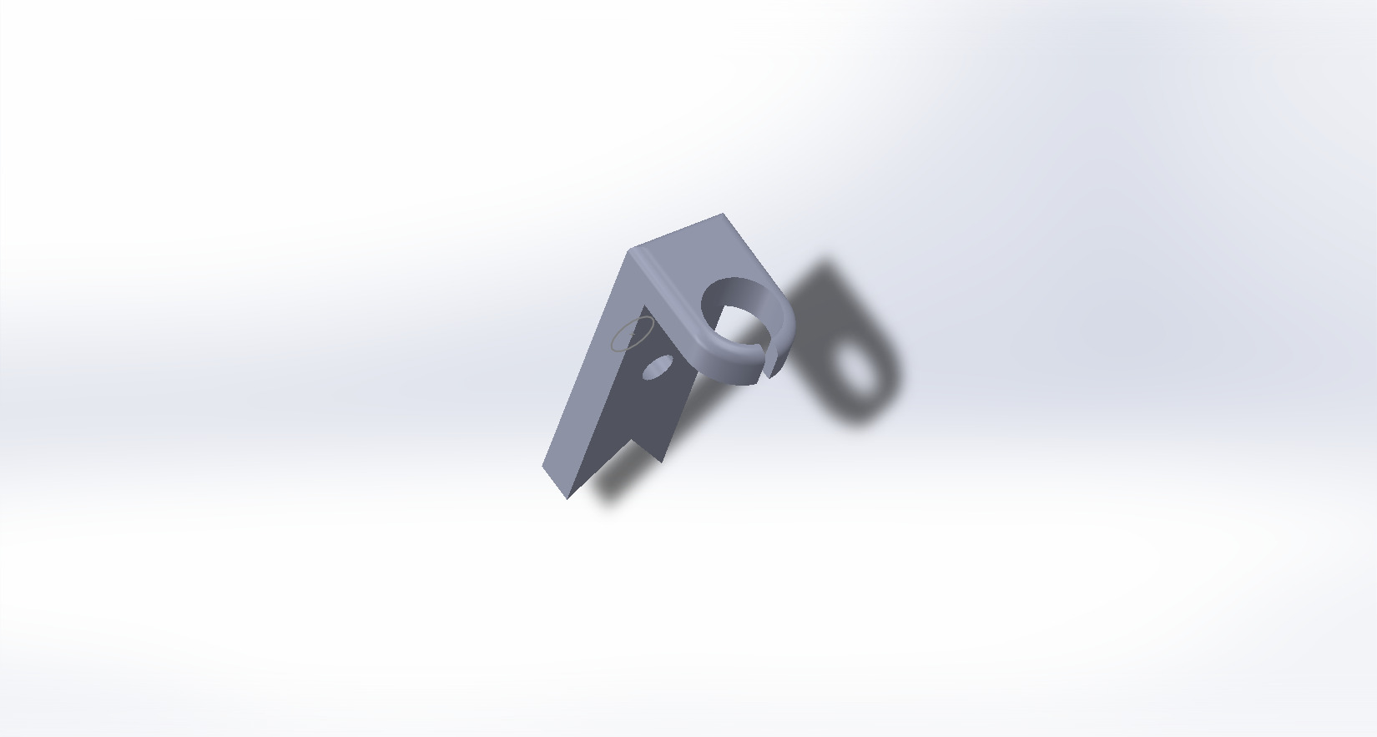
Bracket Holder part 3
designed to handle and transfer the massive braking torque and force
connection between the entire brake caliper assembly and the vehicle's suspension component
Housing for Slide Pins

Slide 8
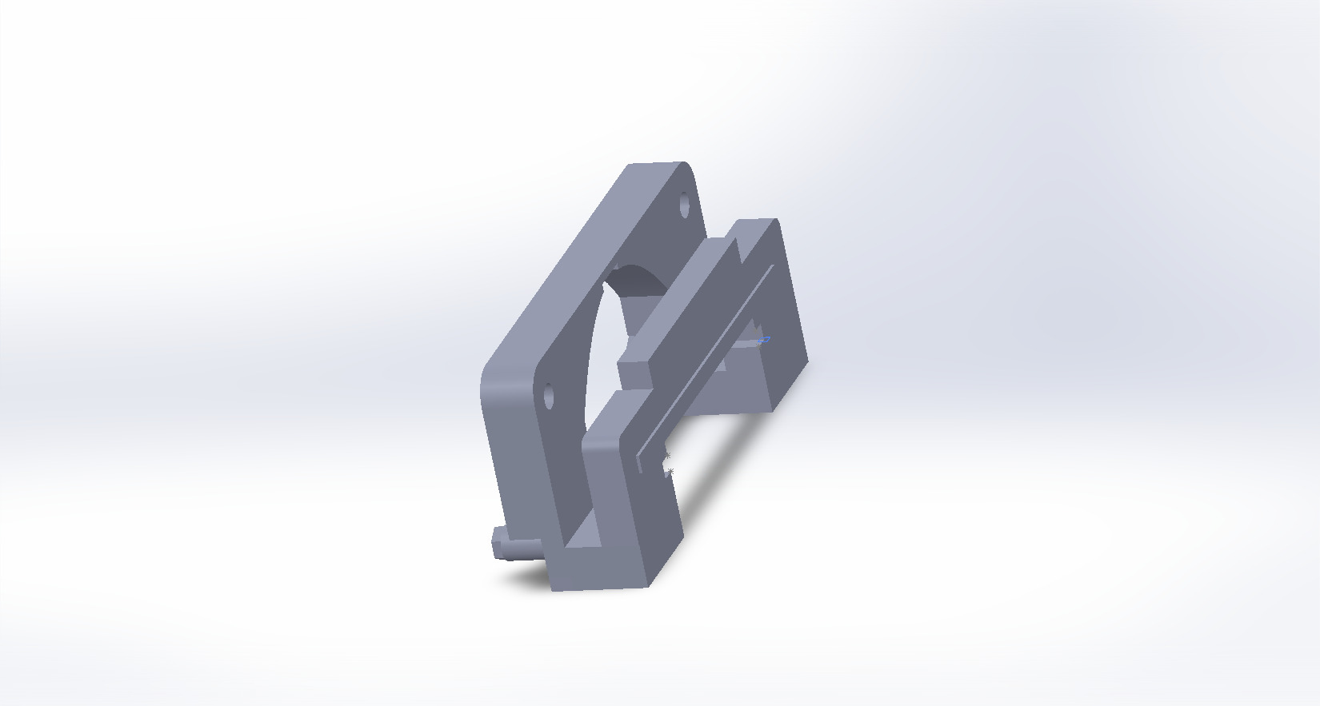
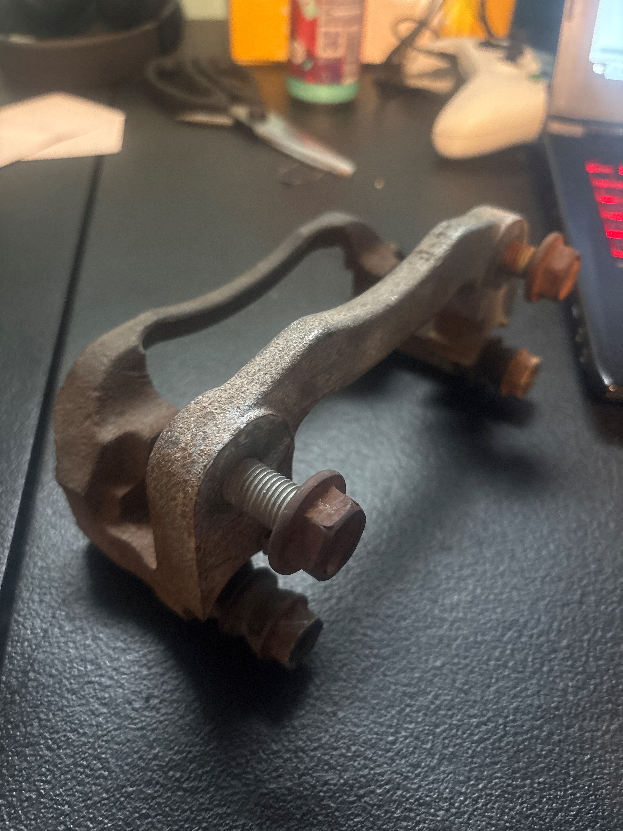
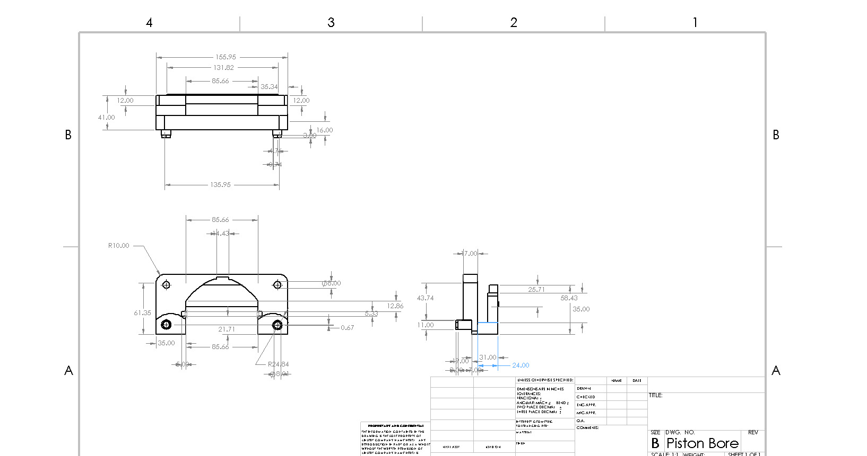
Piston Bore

Slide 9
Piston Bore Need
Guides the Caliper Piston to slide in and out of. When you press the brake pedal, hydraulic fluid enters the back of this bore, and the resulting pressure pushes the piston out.
converts fluid pressure into the mechanical force needed to apply the brake.

Slide 10
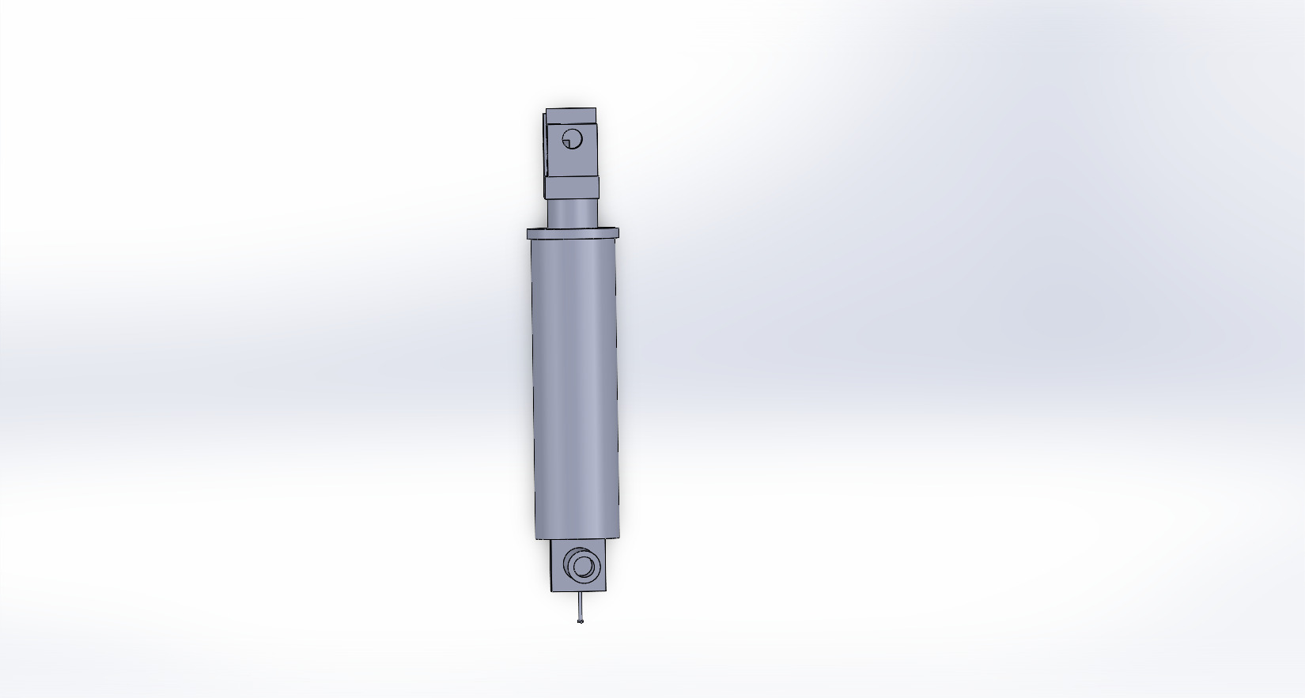
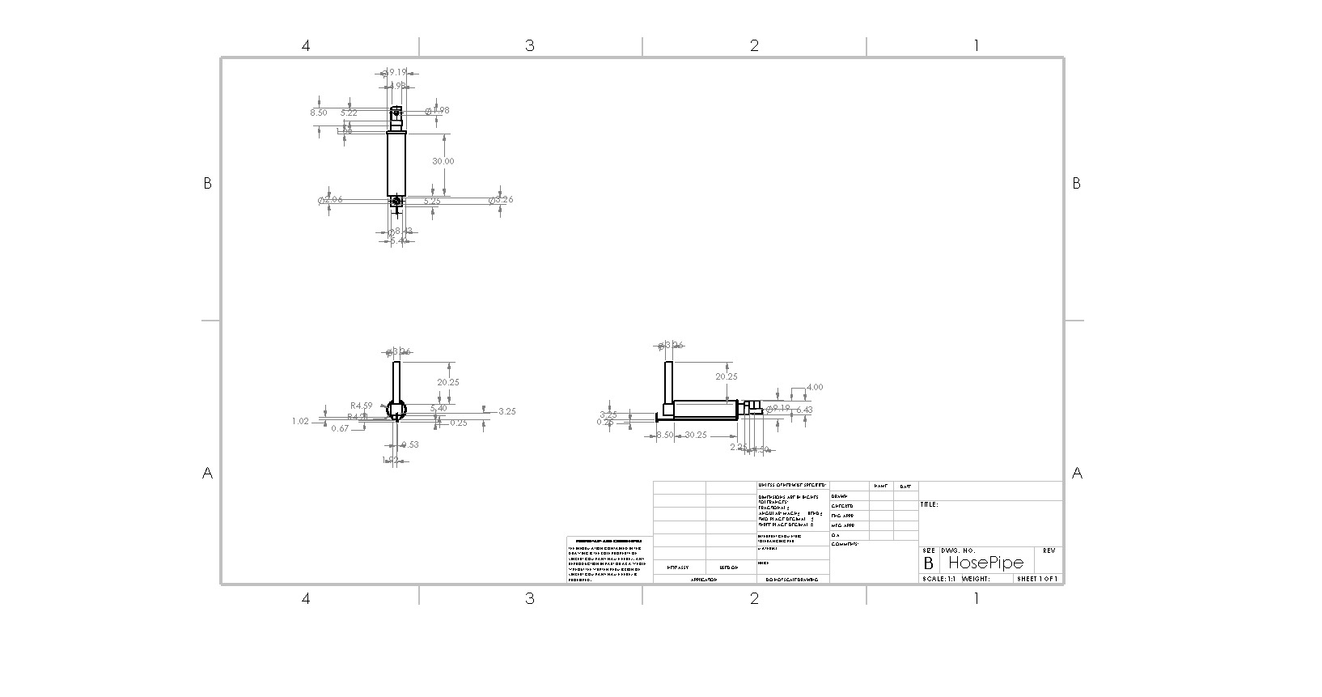
Hose Pipe
- transfer the highly pressurized brake fluid from the rigid Brake Line (which runs along the car's body) to the Caliper Body at the wheel.

Slide 11
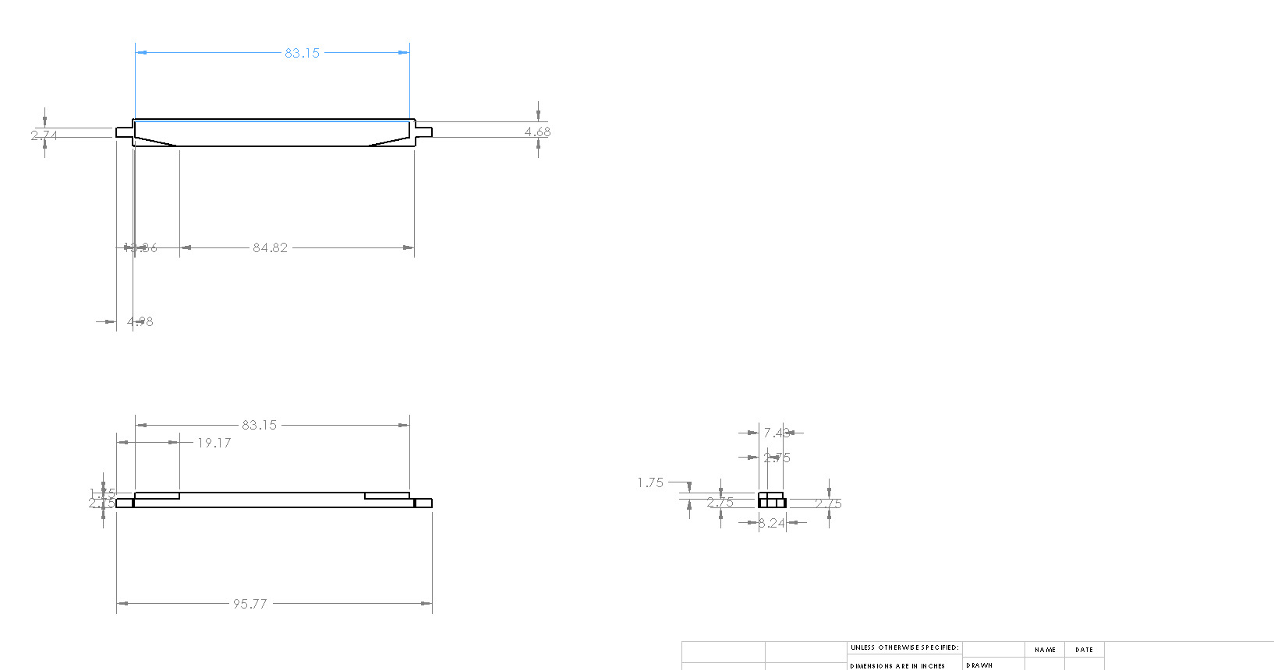
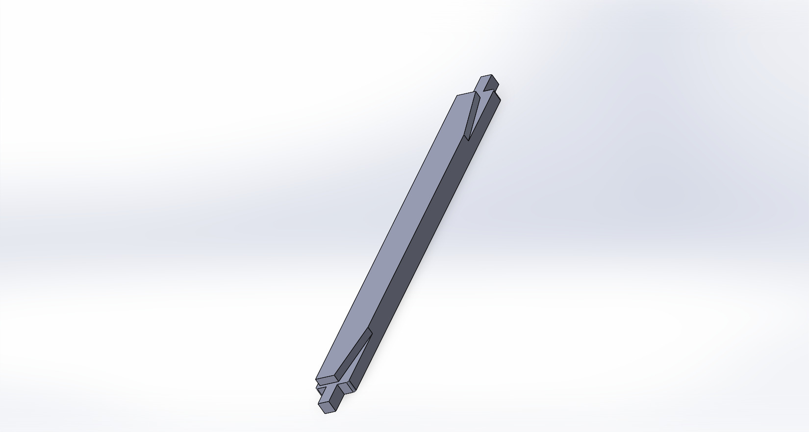
Brake Pad
Inner Pad - It sits directly against the Caliper Piston. When you apply the brakes, the piston pushes this pad first, pressing it against the rotor.
Outer Pad - As the piston pushes the inner pad, the reaction force causes the entire caliper body to slide inward on the Caliper Guide Pins, pulling the outer pad against the opposite side of the rotor.

Slide 12
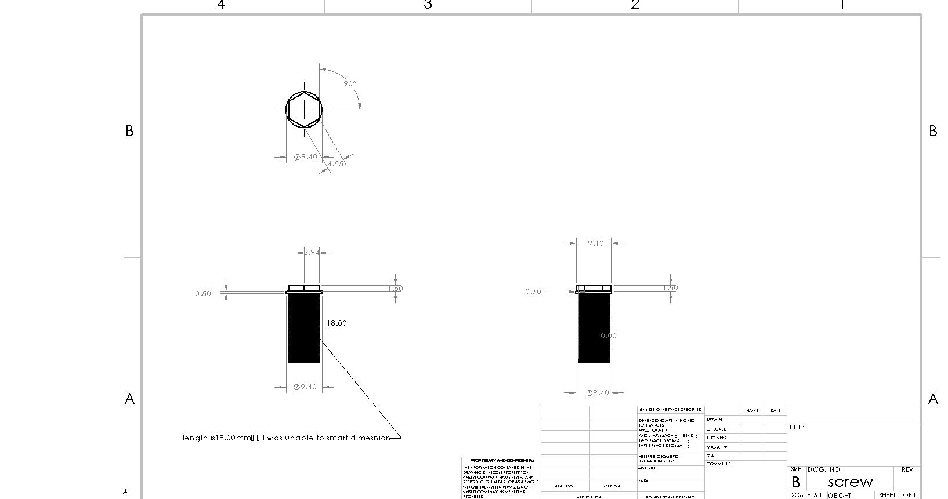
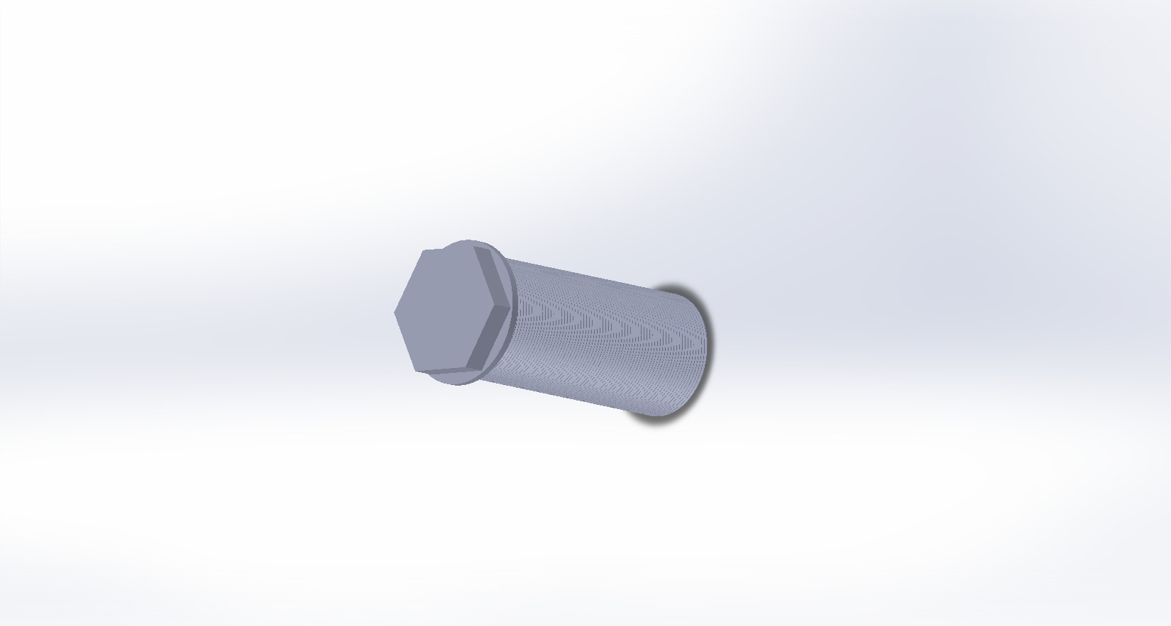
Screws/Bolts
Every part I used is meant to work with this one screw(18mm length)
Holds everything together
One part, near the body, the bleeder screw allows a mechanic to purge (bleed) air and old fluid from the system.
Also Caliper Guide Pin Bolt

