Slide 1
Introduction Slide
We want to predict carbon pollution through the data(NOx)
Comes from Python files(http://drnam.org/pythonfiles/traffic.csv)

Slide 2
Goal of Project and Why it is important
It's important because we don’t want to damage our environment or ourselves more through excess waste like NOx. There is strong evidence that NOx respiratory exposure can trigger and exacerbate existing asthma symptoms and may even lead to the development of asthma over longer periods of time. It has also been associated with heart disease, diabetes, birth outcomes, and all-cause mortality.

Slide 3
Methods
Libraries
Step 1: Get the data
Step 2: Clean the data
Step 3: Split the data into the train and test
Step 4: Inspect the data
Step 5: Split features from labels
Step 6: Create a normalization layer
Step 7: Linear regression
One Variable
Multiple inputs
Step 8: A DNN regression
One variable
Full model
Step 9: Make predictions
Seaborn
Tensorflow
Pandas
Numpy
Matplotlib
Deep Neural Networks
We used DNN so tensor flow could work, and so we could find more data if we need too. (DNN assisted to predicting the data.)
Model: "sequential_2"
┏━━━━━━━━━━━━━━━━━━━━━━━━━━━━━━━━━━━━━━┳━━━━━━━━━━━━━━━━━━━━━━━━━━━━━┳━━━━━━━━━━━━━━━━━┓ ┃ Layer (type) ┃ Output Shape ┃ Param # ┃ ┡━━━━━━━━━━━━━━━━━━━━━━━━━━━━━━━━━━━━━━╇━━━━━━━━━━━━━━━━━━━━━━━━━━━━━╇━━━━━━━━━━━━━━━━━┩ │ normalization_1 (Normalization) │ (None, 1) │ 3 │ ├──────────────────────────────────────┼─────────────────────────────┼─────────────────┤ │ dense_2 (Dense) │ (None, 64) │ 128 │ ├──────────────────────────────────────┼─────────────────────────────┼─────────────────┤ │ dense_3 (Dense) │ (None, 64) │ 4,160 │ ├──────────────────────────────────────┼─────────────────────────────┼─────────────────┤ │ dense_4 (Dense) │ (None, 1) │ 65 │ └──────────────────────────────────────┴─────────────────────────────┴─────────────────┘
Total params: 4,356 (17.02 KB)
Trainable params: 4,353 (17.00 KB)
Non-trainable params: 3 (16.00 B)

Slide 4
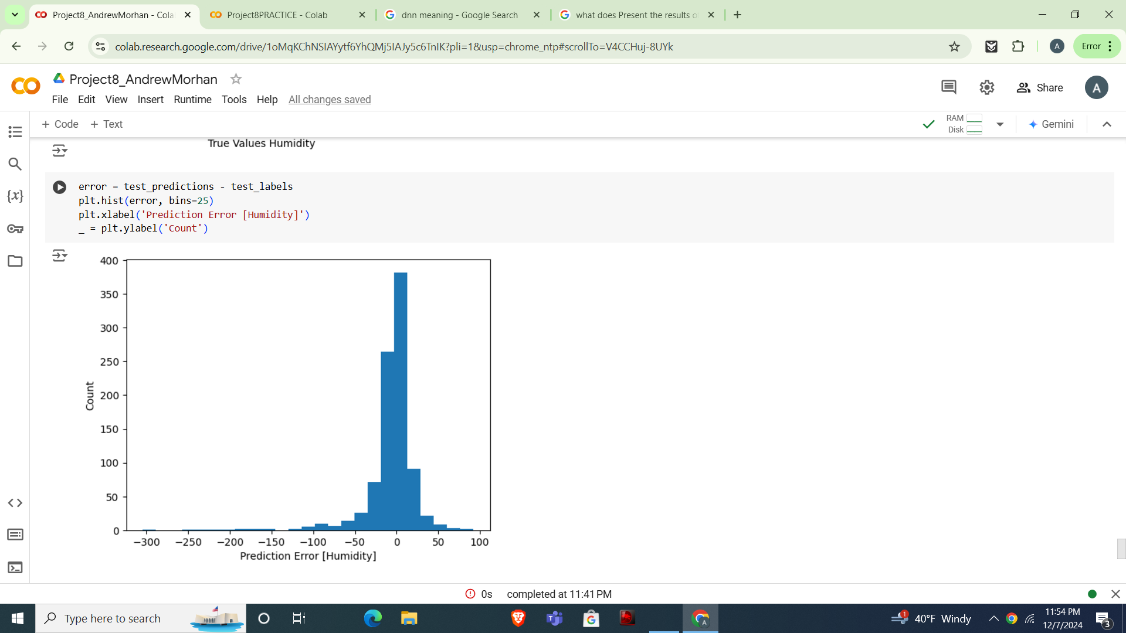
Results and analysis
The result of our analysis showed predicated rates of higher humidity with NOX.
We couldn’t use Pm2.5 as a variable due to its similarities of Nox. It messed up with tensorflows library (Unable to predict the data.) What we instead used was humidity, due to it being the first option available. We could’ve used car or truck or any others and it would have worked fine.

Slide 5
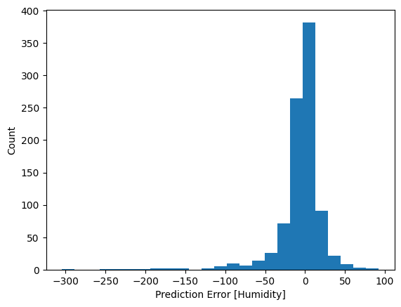
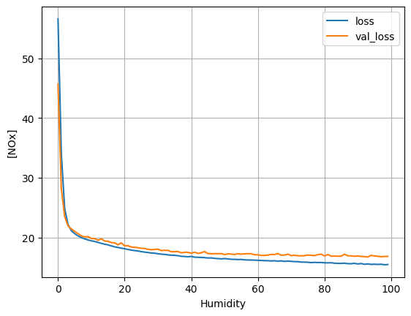
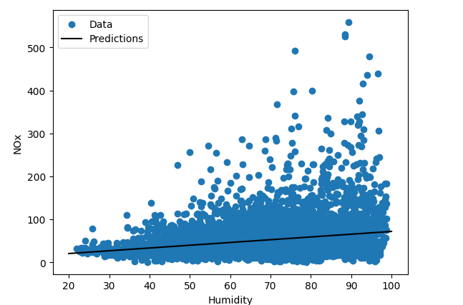
Results and analysis
Areas we struggled were figuring out what variables to use along with having to delete time and date completely.
NOx
284 | 43.992
95 | 12.596
4370 | 48.880
2664 | 5.828
3442 | 35.156
Include visuals to help convey your findings, such as:
A graph showing predicted vs. actual values.
Loss curves for training and validation data.
Highlight the key observations from your results, such as any patterns the model captured, areas where it struggled, or evidence of overfitting/underfitting.

Slide 6
Conclusion
In conclusion, what we found was the toxicity of NOx and its relation to humidity
Python predicts that humidity will increase overtime.
Problem
How much NOx is produced inside of traffic overtime and its relation to the intense humidity that is involved with it
Application in real life
This model can be applied In real life to help inform future environmental scientists and engineers to help combat the pollution that NOx would provide
. Conclusion and Recommendations
Summarize your findings and provide a clear conclusion based on the results.
Reflect on what the results mean in the context of the problem you’re addressing.
Suggest improvements for the model, such as using more data, engineering additional features, or optimizing hyperparameters.
Offer ideas for further research or how the model might be applied in real-world scenarios.
Improvements for the model
We had to alter our code by getting rid of PM2.5, what we found was it was too like NOx and made the overload intense. We also had to manually delete the Date and Time columns to prevent further errors from occurring.

Slide 7
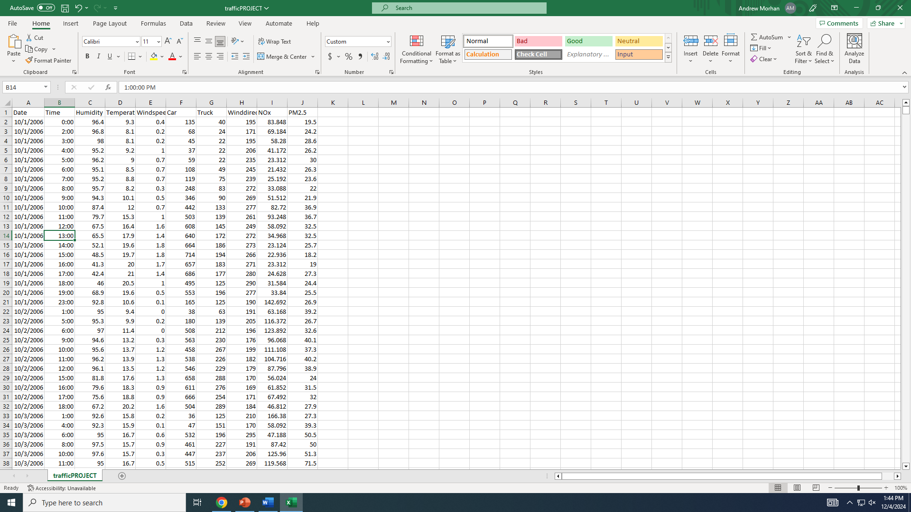
References
The data set we analyzed was traffic.csv
It comes from the python file
(Which is also an excel spreadsheet):
http://drnam.org/pythonfiles/traffic.csv
We received help from the following libraries
Matplotlib.pyplot – The library we used to create 2D plots. It mimics MATLAB's plotting function.
Numpy – Works with math/data in lists and tables.
Pandas – Helps to organize and manipulate data in tables, rows, and columns.
Seaborn – Makes the graphs and charts more visually pleasing and easier to understand.
Tensorflow – Helps the computer to make patterns and predictions from previous data
Websites/Articles :
NOx - Wikipedia

Slide 8
Additional Notes
Additional Notes for Your Presentation
Use clear and concise language to make the content easy to understand briefly.
Include visual elements like graphs and tables to support your analysis.
Organize the poster in a logical flow, with each section clearly separated and labeled.

